Slide 1

CSE 3121
Database Management Systems
Session: 2016-17
Dr. Asif Zaman
Associate Professor, CSE, RU
Week # 1

Slide 2
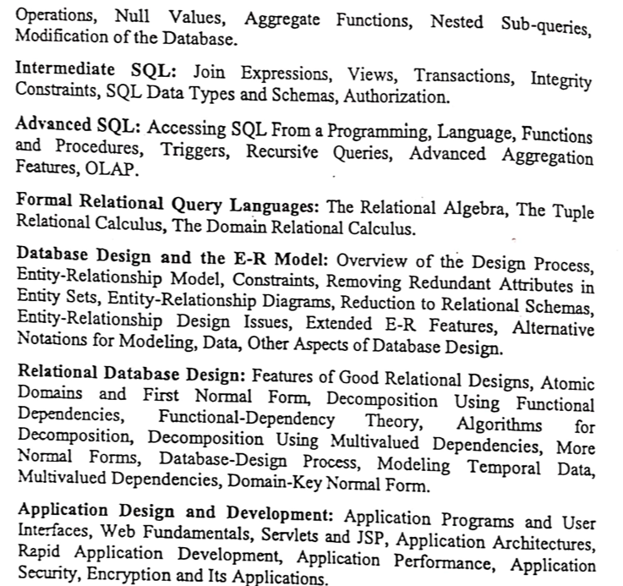
Course Contents

Slide 3
Features of Good Relational Design
The goal of relational database design is to generate a set of relation schemas that allows us to:
store information without unnecessary redundancy, yet
also allows us to retrieve information easily.
This is accomplished by designing schemas that are in an appropriate normal form.
To determine whether a relation schema is in one of the desirable normal forms, we need information about the real-world enterprise that we are modeling with the database.

Slide 4
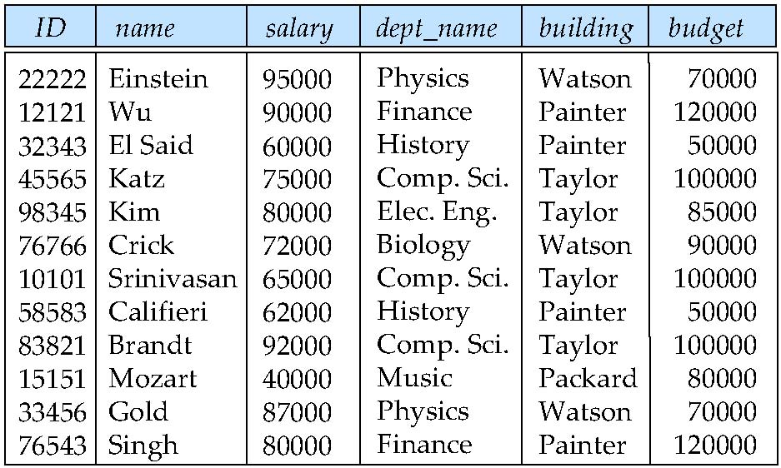
Combine Schemas?
Suppose we combine instructor and department into inst_dept
Result is possible repetition of information
New Dept. Ins??

Slide 5
What About Smaller Schemas?
Suppose we had started with inst_dept. How would we know to split up (decompose) it into instructor and department?
Write a rule “if there were a schema (dept_name, building, budget), then dept_name would be a candidate key”
Denote as a functional dependency:
dept_name → building, budget
In inst_dept, because dept_name is not a candidate key, the building and budget of a department may have to be repeated.
This indicates the need to decompose inst_dept

Slide 6
What About Smaller Schemas?
Not all decompositions are good.
Suppose we decompose employee(ID, name, street, city, salary) into
employee1 (ID, name)
employee2 (name, street, city, salary)
The next slide shows how we lose information -- we cannot reconstruct the original employee relation -- and so, this is a lossy decomposition.

Slide 7
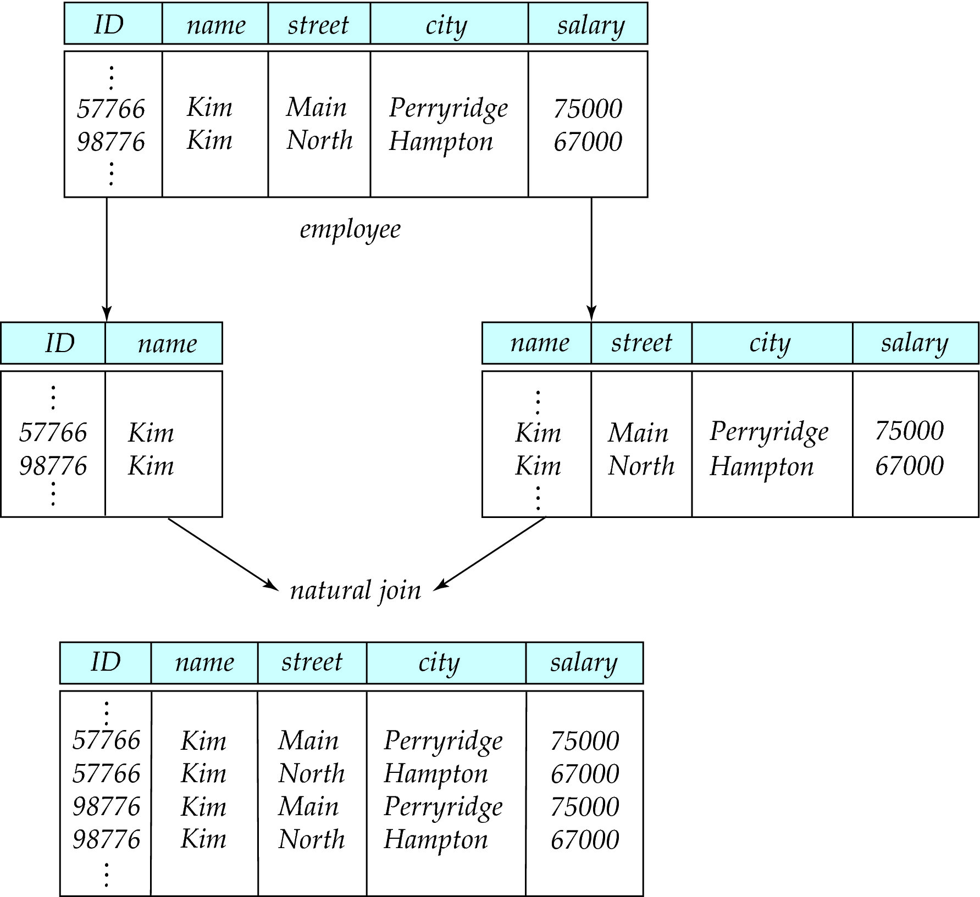
A Lossy Decomposition

Slide 8
Example of Lossless-Join Decomposition
Lossless join decomposition
Decomposition of R = (A, B, C) R₁ = (A, B) R₂ = (B, C)
A
B
C
A
B
B
C
α
β
1
2
A
B
α
β
1
2
1
2
A
B
r
∏_{A,B}(r)
∏_{B,C}(r)
∏_{A} (r) ∏_{B} (r)
A
B
C
α
β
1
2
A
B

Slide 9
First Normal Form
Domain is atomic if its elements are considered to be indivisible units
Examples of non-atomic domains:
Set of names, composite attributes
Identification numbers like CS101 that can be broken up into parts

Slide 10
First Normal Form
A relational schema R is in first normal form (1NF) if the domains of all attributes of R are atomic
Non-atomic values complicate storage and encourage redundant (repeated) storage of data
Example: Set of accounts stored with each customer, and set of owners stored with each account
We assume all relations are in first normal form

Slide 11
First Normal Form (Cont’d)
Atomicity is actually a property of how the elements of the domain are used.
Example: Strings would normally be considered indivisible
Suppose that students are given roll numbers which are strings of the form CS0012 or EE1127
If the first two characters are extracted to find the department, the domain of roll numbers is not atomic.
Doing so is a bad idea: leads to encoding of information in application program rather than in the database.

Slide 12
Goal — Devise a Theory for the Following
Decide whether a particular relation R is in “good” form.
In the case that a relation R is not in “good” form, decompose it into a set of relations {R₁, R₂, ..., R_{n}} such that
each relation is in good form
the decomposition is a lossless-join decomposition
Our theory is based on:
functional dependencies
multivalued dependencies

Slide 13
Functional Dependencies
Constraints on the set of legal relations.
Require that the value for a certain set of attributes determines uniquely the value for another set of attributes.
A functional dependency is a generalization of the notion of a key.

Slide 14
Functional Dependencies (Cont.)
Let R be a relation schema
α ⊆ R and β ⊆ R
The functional dependency
α → β holds on R if and only if for any legal relations r(R), whenever any two tuples t₁ and t₂ of r agree on the attributes α, they also agree on the attributes β. That is,
t₁[α] = t₂ [α] ⇒ t₁[β ] = t₂ [β ]
Example: Consider r(A,B ) with the following instance of r.
On this instance, A → B does NOT hold, but B → A does hold.
4
1 5
3 7

Slide 15
Functional Dependencies (Cont.)
K is a superkey for relation schema R if and only if K → R
K is a candidate key for R if and only if
K → R, and
for no α ⊂ K, α → R
Functional dependencies allow us to express constraints that cannot be expressed using superkeys.
inst_dept (ID, name, salary, dept_name, building, budget ).
We expect these functional dependencies to hold:
dept_name → building & ID → building
but would not expect the following to hold:
dept_name → salary

Slide 16
Use of Functional Dependencies
We use functional dependencies to:
test relations to see if they are legal under a given set of functional dependencies.
If a relation r is legal under a set F of functional dependencies, we say that r satisfies F.
specify constraints on the set of legal relations
We say that F holds on R if all legal relations on R satisfy the set of functional dependencies F.

Slide 17
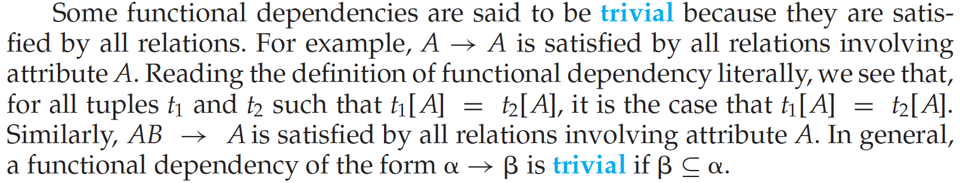
Functional Dependencies (Cont.)
A functional dependency is trivial if it is satisfied by all instances of a relation
Example:
ID, name → ID
name → name
In general, α → β is trivial if β ⊆ α

Slide 18
Closure of a Set of Functional Dependencies
Given a set F of functional dependencies, there are certain other functional dependencies that are logically implied by F.
For example: If A → B and B → C, then we can infer that A → C
The set of all functional dependencies logically implied by F is the closure of F.
We denote the closure of F by F⁺.
F⁺ is a superset of F.

Slide 19
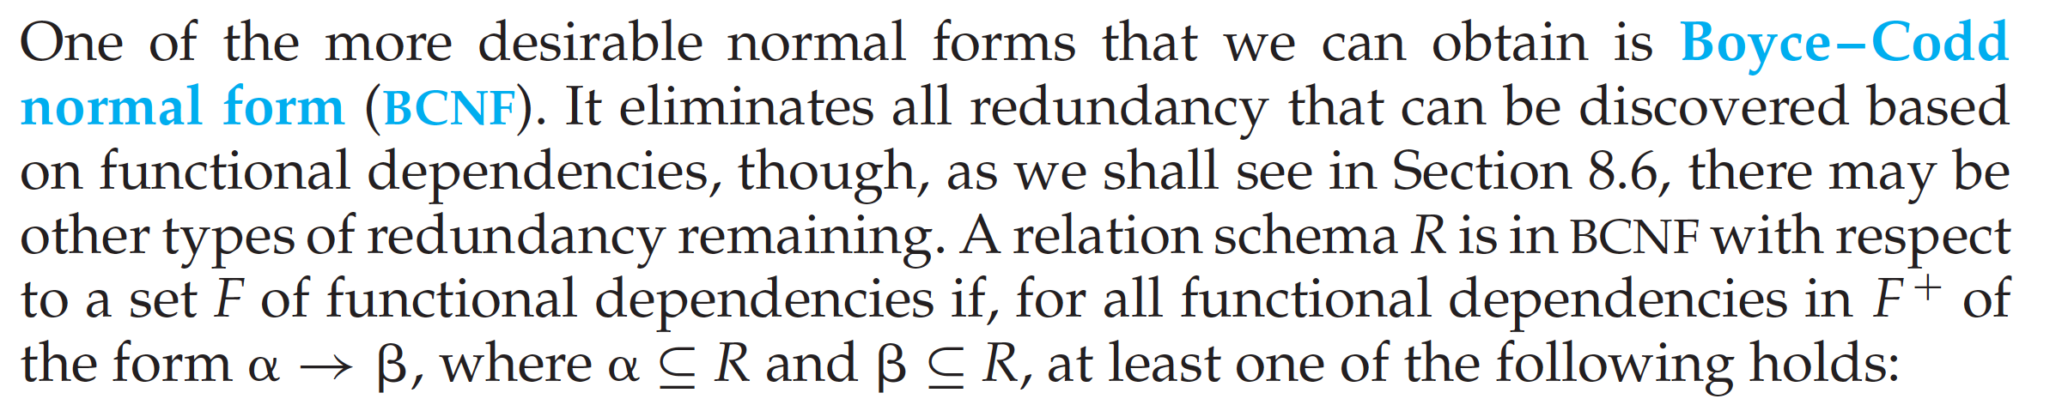
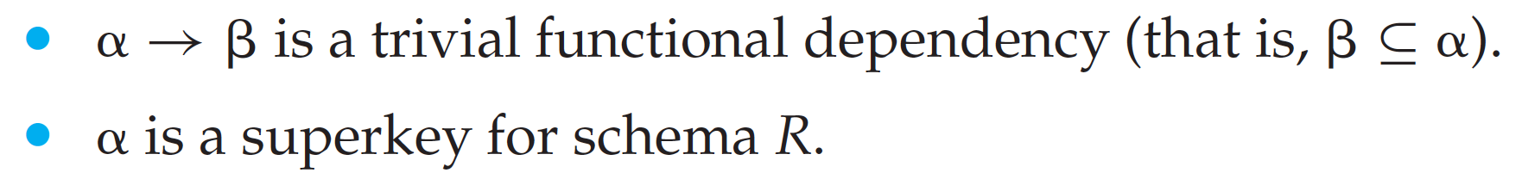
Boyce-Codd Normal Form (BCNF)

Slide 20
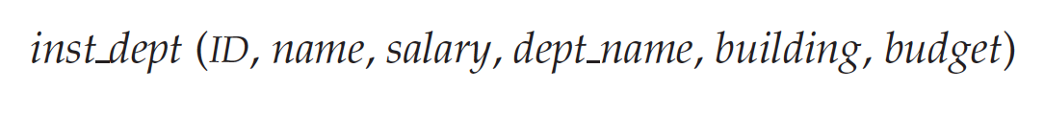
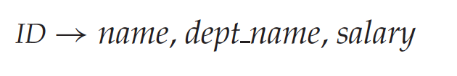

Boyce-Codd Normal Form (BCNF)

Slide 21
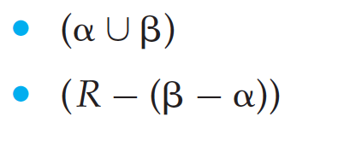
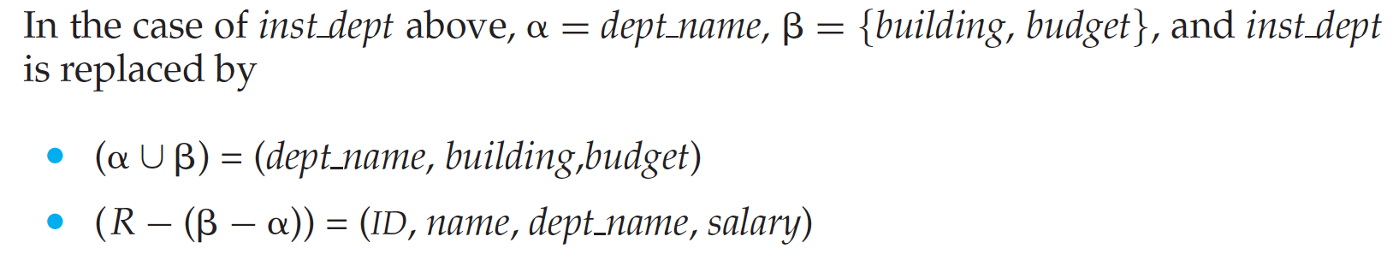
Decomposing a Schema into BCNF
Suppose we have a schema R and a non-trivial dependency α→β causes a violation of BCNF.
We decompose R into:

Slide 22
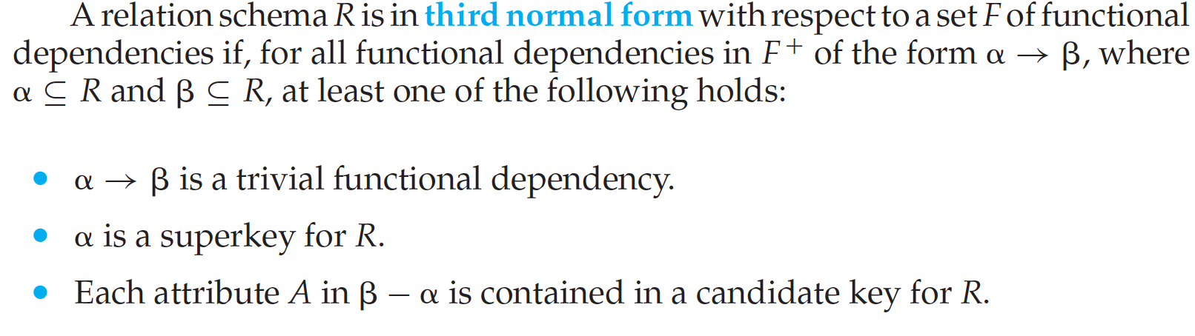
Third Normal Form

Slide 23
Goals of Normalization
Let R be a relation scheme with a set F of functional dependencies.
Decide whether a relation scheme R is in “good” form.
In the case that a relation scheme R is not in “good” form, decompose it into a set of relation scheme {R₁, R₂, ..., R_{n}} such that
each relation scheme is in good form
the decomposition is a lossless-join decomposition
Preferably, the decomposition should be dependency preserving.

Slide 24
Functional-Dependency Theory
We now consider the formal theory that tells us which functional dependencies are implied logically by a given set of functional dependencies.
We then develop algorithms to generate lossless decompositions into BCNF and 3NF
We then develop algorithms to test if a decomposition is dependency-preserving

Slide 25
Closure of a Set of Functional Dependencies
Given a set F set of functional dependencies, there are certain other functional dependencies that are logically implied by F.
For e.g.: If A → B and B → C, then we can infer that A → C
The set of all functional dependencies logically implied by F is the closure of F.
We denote the closure of F by F⁺.

Slide 26
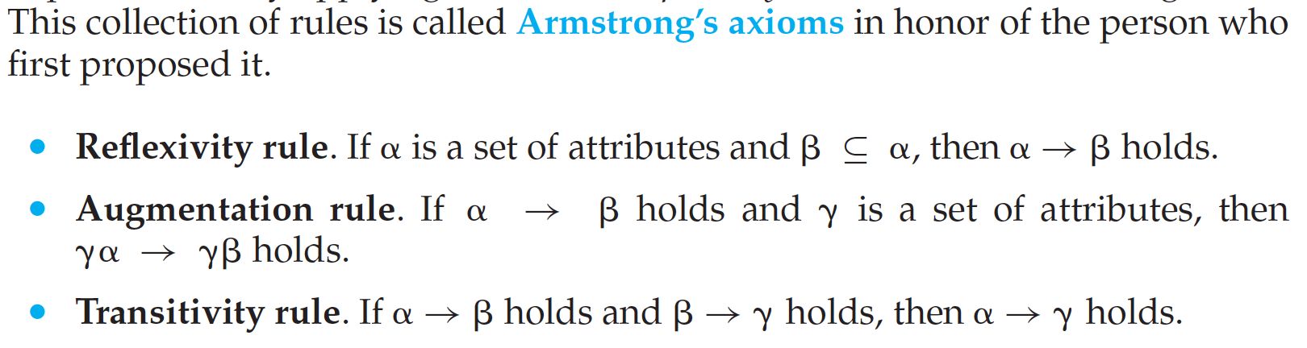
Closure of a Set of Functional Dependencies
These rules are
sound (generate only functional dependencies that actually hold), and
complete (generate all functional dependencies that hold).

Slide 27
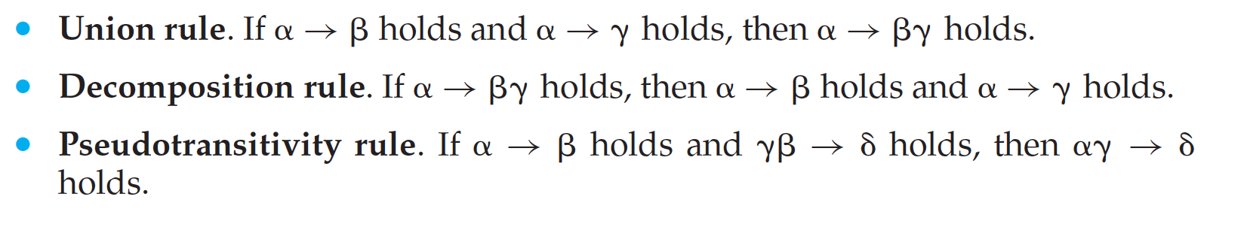
Closure of a Set of Functional Dependencies

Slide 28
Example
R = (A, B, C, G, H, I) F = { A → B A → C CG → H CG → I B → H }
some members of F⁺
A → H
by transitivity from A → B and B → H
AG → I
by augmenting A → C with G, to get AG → CG and then transitivity with CG → I

Slide 29
Example
CG → HI
by augmenting CG → I to infer CG → CGI,
and augmenting of CG → H to infer CGI → HI,
and then transitivity

Slide 30
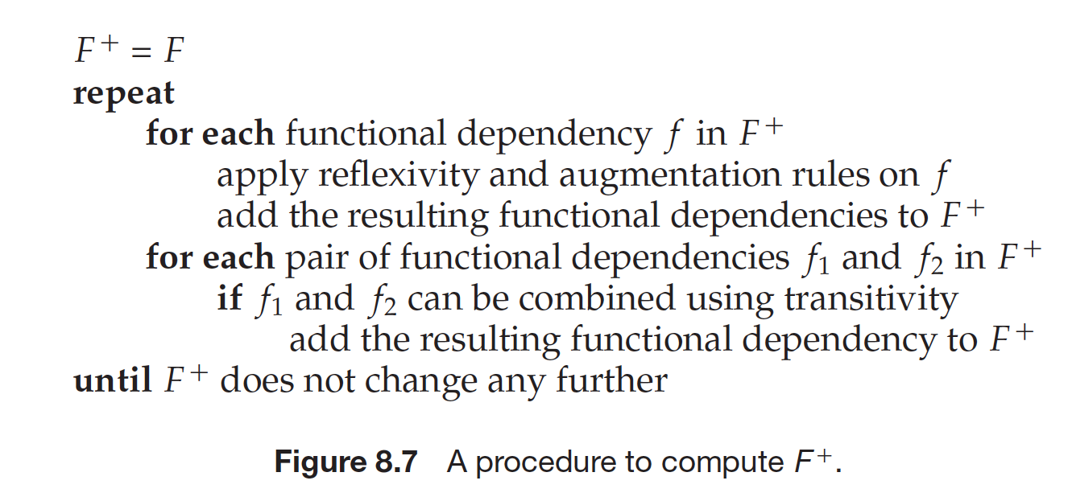
Procedure for Computing F⁺

Slide 31
End of Class

